Slide 1

JSS science and technology university Foot ball tournament 2021 JSS center for management studies, JSS technical institution campus, JSS CMS
JSS FOOTBALL
INTER COLLEGE FOOTBALL TOURNAMENT
MARCH 10TH 2021 AT SJCE GROUNDS
SPONSERED BY:
COCO NEXT
FOR REGISTRATIONS CONTACT
CHIRAG N 8904748475
DHANUSH BOLAR K 8797896756

Slide 2
CASH PRIZE AND TROPHY FOR WINNERS
REGISTRATION
ENTRY FEE 2000 PER TEAM
REWARDS
CASH PRIZE 50K AND TROPHY
SL NO PROGRAMME TIME
1 INAUGRATION 9:00
2 MATCH STARTS 10:00
3 LUNCH BREAK 1:00
4 MATCH STARTS 2:00
5 SEMI FINALS 4:00
6 FINALS 5:30

Slide 3
RULES & REGULATIONS.
Tournament Format:
UNLESS OTHERWISE STATED, THE GAME WILL BE PLAYED ACCORDING TO FIFA LAWS.
All categories will play 7-a-side. The match will consist of two 12 minute periods, with 2 minute halftime, and using an age appropriate ball.
There will be a maximum of 2 minutes of added time, as determined by the referee.
Each team must have a minimum of 4 players on the field to play the match. A maximum of 12 registered players allowed per game.
Number of games played in the Group & Championship Stages is dependent on the number of teams in the group.
The offside law will not apply.
Heading the ball is acceptable in all divisions.
Result scoring will be as follows: Win = 3pnts, Draw = 1pnt, Loss = 0pnts
All players are highly recommended to wear shin guards and proper equipment for their own protection.
Substitutions will be unlimited and will occur without stoppage of play. However, all players must have the referee’s permission before they can enter the field of play and they must wait for the substituted player to leave the field.
Teams must be on the field and ready to play for the scheduled kick off time. If a team is late to the field they will be penalized by two goals (eg. The late team will start the match losing 0-2). If a team is more than 5 minutes late for the match, they will forfeit the game by a score of 0-3.
The referee’s word in all cases is final. The referees have been instructed to issue cards to any player who shows dissent.

Slide 4
ELIGIBILITY
Boys Age Groups – Players can only play for 1 team per age group.
Girls – Players can play in a maximum of 2 teams or 2 Age Groups, as long as they are age appropriate and registered online with both teams. They need to register for both teams and receive 2 age group confirmations.
Submission of ineligible players may render the team to be disqualified from the tournament.
Female players can play one (1) year older in the boys age group
All players’ team lists should be submitted into the new online registration system with a player picture and players D.O.B No later than June 10th, 2019.
All team managers must sign a waiver document releasing all parties working for or organizing of the Asia Pacific Football Tournament of all liabilities associated with the tournament.
Every participating team/club will be eligible to inspect any team registration list of any team in their age group before any particular match at the Registration Tent. This can only be done by the Team Manager and NOT any parents.
Tie Breakers:
During the group stages, all matches that end in a draw will stay as such, with 1 point being awarded to each team.
In the event of a tie in the standings, we will use the following measures to determine the winner: 1) Goal Differential, 2) Goals For, 3) Head to Head, 4) Sudden Death Penalty Shoot-out.
If a playoff or championship match ends in a draw, the match will be decided using the following format:

Slide 5
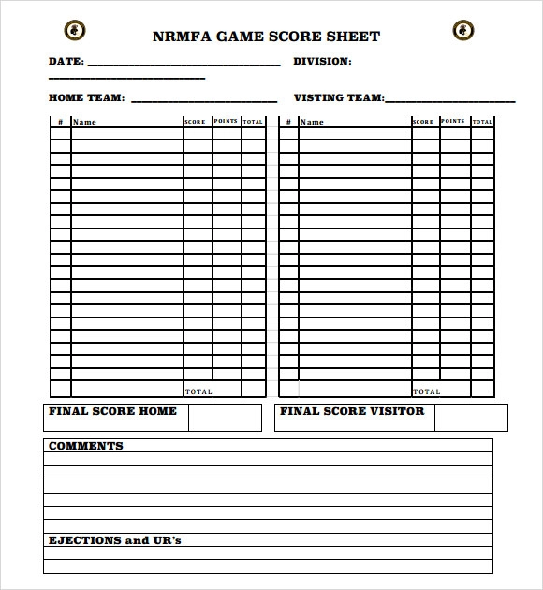

Slide 6
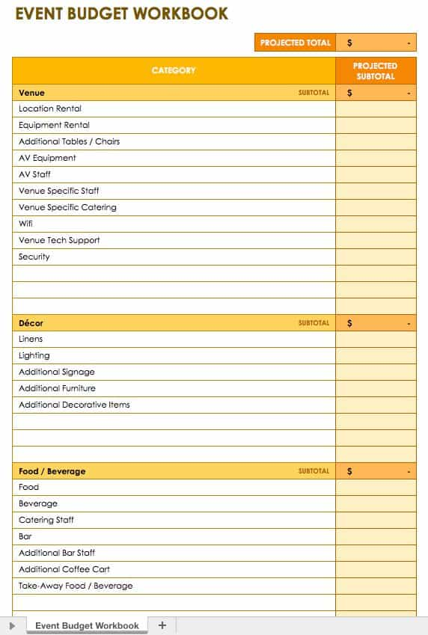

Slide 7
EVENT HEADS PROF.RAHUL PROF.LOHITH EVENT COORDINATORS MANJUNATH GOWTHAM MOHAN SUHAS PRADYUM NISCHAL

